Slide 1
Sign Language Translation
2451-20-733-019 P.Pujitha
2451-20-733-024 Aaftab Raahi
2451-20-733-035 M.Divya Sri
INTERNAL GUIDE:
M.Madhuri,Asst.Professor ,CSED

Slide 2
PROBLEM STATEMENT
To develop an automated sign language translation system that can accurately analyze sign language gestures captured in videos and provide real-time textual representations of the signed content.
The system should be able to capture real-time video feed from the webcam, detect and track hand and body movements using the Mediapipe library, and translate those movements into corresponding language gestures or actions.
The goal is to enable communication between individuals who use sign language and those who do not understand sign language, bridging the communication gap and promoting inclusivity.

Slide 3
EXISTING SYSTEM
Before the development of this project, existing sign language translation systems primarily relied on computer vision techniques and image processing algorithms.
The system involved Hand detection and tracking as well as Gesture Recognition.
Limitations:
They often struggled with robust hand detection and tracking, especially in varying lighting conditions, complex backgrounds, or when multiple hands were present.
These systems required explicit training and predefined gesture databases, limiting their flexibility and adaptability to new or custom gestures.

Slide 4
PROPOSED SYSTEM
To develop system a comprehensive and accurate sign language translation system using computer vision and machine learning techniques.
The system will overcome the limitations of the existing system by providing by providing real-time sign language gestures into written or spoken language.

Slide 5
SCOPE
Implement hand and body tracking: Utilize the Mediapipe library to accurately detect and track the user's hand and body movements in real-time.
Train LSTM neural networks: Develop and train LSTM neural networks to recognize sign language gestures based on the hand and body tracking data. The neural networks will learn to map the tracked gestures to their corresponding sign language words, phrases, or actions.
Real-time translation: Provide instant translation of sign language gestures into written or spoken language. The system should accurately interpret the gestures recognized by the neural networks and convert them into meaningful and understandable output.

Slide 6
TOOLS AND TECHNOLOGIES
Python
Tensorflow
OpenCV
Media pipe
Scikit-learn
Matplotlib
Jupyter Notebook

Slide 7
SOFTWARE AND HARDWARE REQUIREMENTS
Software Requirements:
Operating System: Windows
Programming Language: Python
Integrated Development Environment(IDE): Jupyter Notebook
Computer Vision Libraries: OpenCV, Media Pipe, Tensorflow
Hardware Requirements:
Computer: Computer with a multi-core processor such as Intel Core i5 and at least 8GB RAM are recommended.
Camera: A high quality camera capable of capturing clear video footage.

Slide 8
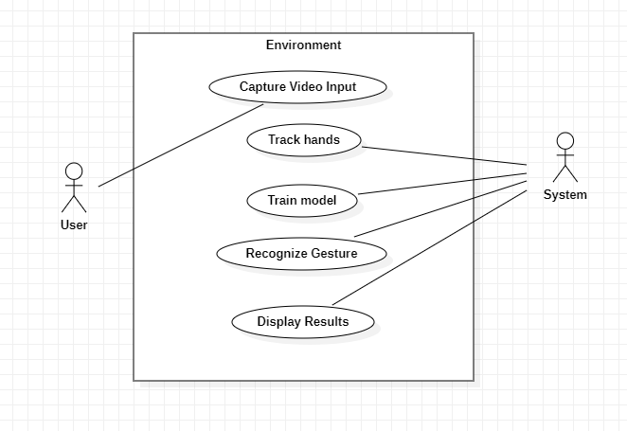
SYSTEM DESIGN
USE CASE Diagram:

Slide 9
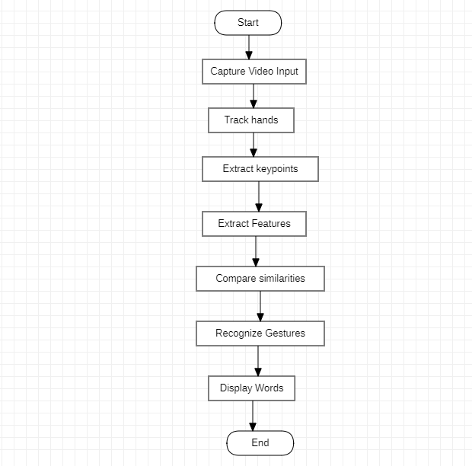
SYSTEM DESIGN
FLOWCHART Diagram:

Slide 10
SYSTEM IMPLEMENTATION
Phases of building model:
1. Data Collection:
Project incorporates the WLASL (Word-Level American Sign Language) dataset for training and evaluation purposes.
WLASL is a large video dataset for World-level American Sign Language(ASL) recognition, which features 2,000 common different words in ASL.
2.Feature Extraction:
Input: A short video(combination of frames).
Frames are extracted from the video.
Features are extracted from each frame using Mediapipe framework.
Sequential analysis of frames is performed to detect the action being being performed.
The system enables accurate sign language translation.

Slide 11
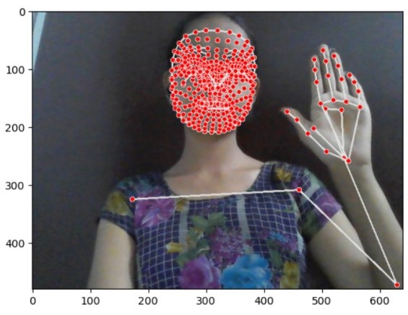
SYSTEM IMPLEMENTATION
Mediapipe Framework:It is an open source library that provides pre-trained models and tools for facial landmark detection, pose estimation, and hand marking, simplifying the process.
HAND: LEFT HAND ,RIGHT HAND
21 POINTS FOR EACH HAND
Each input video is divided into 30 frames.
Each frame has 258 landmarks(features from hands,pose,face)
So each input is of the form (30*258) 2D Vector
We considered only 5 gestures for our project.

Slide 12
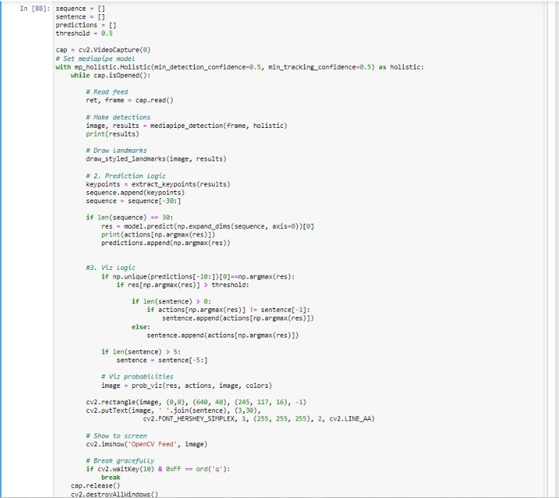
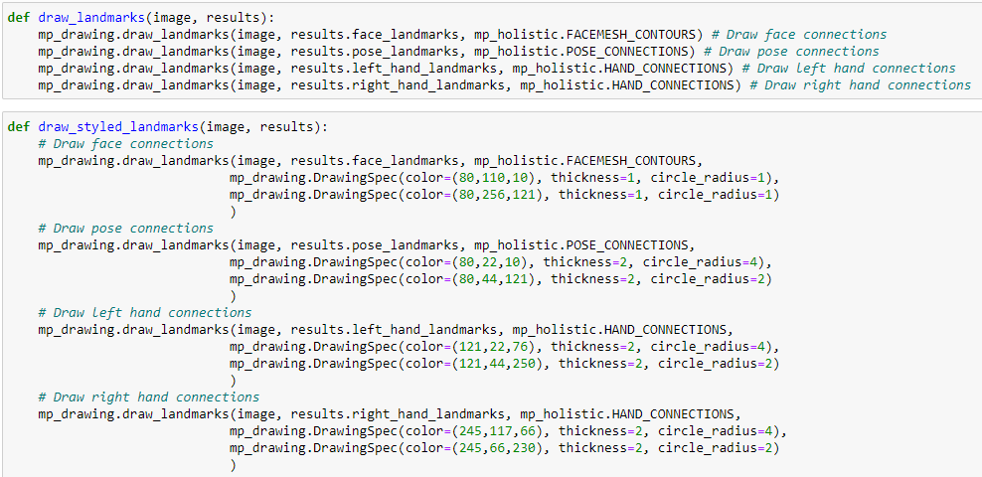
Sample code

Slide 13
3.Model Architecture:
To handle interdependent frames in the input series, we'll use LSTM, a specialized type of RNN. LSTM will enable us to effectively capture temporal patterns and relationships between frames, ensuring accurate action detection and translation in the video data.
Long short-term memory (LSTM) is an artificial recurrent neural network (RNN) architecture used in the field of deep learning (DL). Unlike standard feedforward neural networks, LSTM has feedback connections .
LSTM networks are well-suited to classifying, processing and making predictions based on time series data, since there can be lags of unknown duration between important events in a time series. LSTMs were developed to deal with the vanishing gradient problem that can be encountered when training traditional RNNs. Relative insensitivity to gap length is an advantage of LSTM over RNNs.

Slide 14
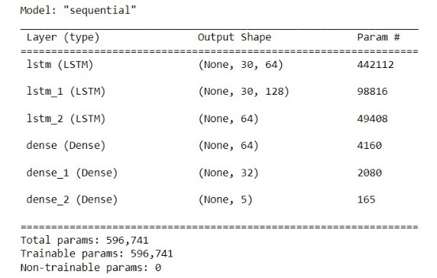
4.Model Training

Slide 15
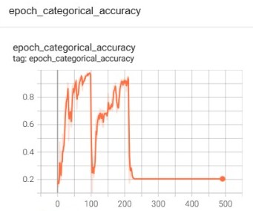
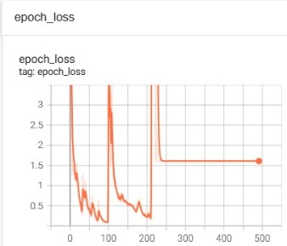
5.Model Testing:

Slide 16
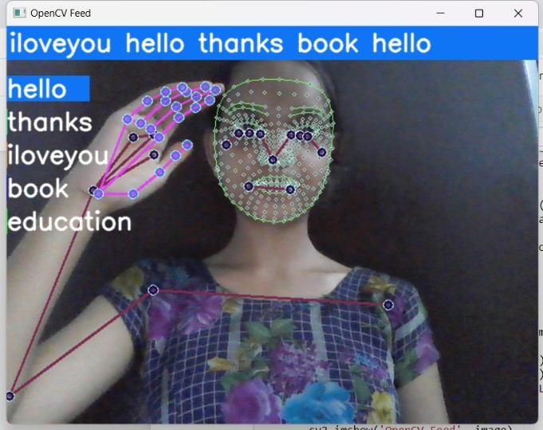
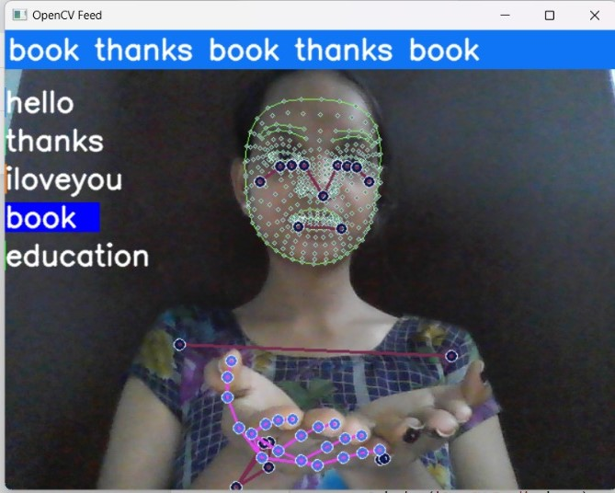
6. Real time Usage
hello
book

Slide 17
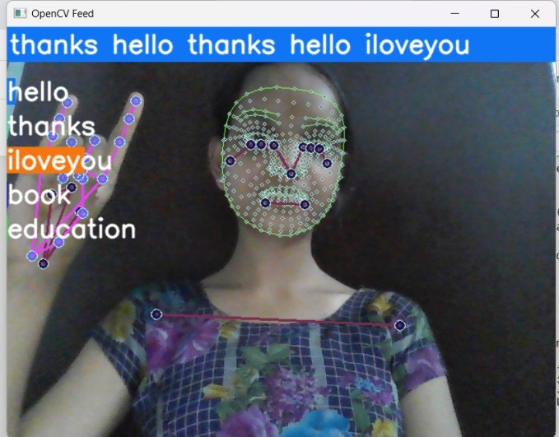
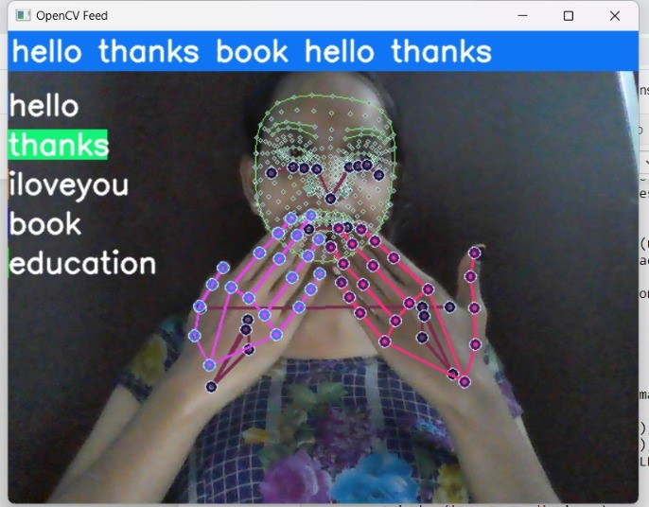
6.Real time Usage
iloveyou
thanks

Slide 18
CONCLUSION
Throughout the project, the system effectively captures and processes video input, detects key landmarks and gestures using the Mediapipe Holistic model, and translates them into corresponding text or spoken language.
The project's achievements include the successful implementation of an LSTM-based neural network for gesture recognition, the creation of a dataset consisting of sign language gestures, and the training of a model to accurately recognize and translate these gestures.
The system provides real-time feedback, enabling interactive communication between sign language users and non-sign language users.

Slide 19
FUTURE SCOPE
Real-time translation: This involve integrating speech synthesis or text generation modules to output the translated text or audio.
Mobile and Wearable Applications:Porting the system to mobile platforms or developing wearable devices for sign language translation.

Slide 20
REFERENCES
Dataset:
https://www.kaggle.com/datasets/risangbaskoro/wlasl-processed
Source code:
http://localhost:8888/notebooks/Downloads/Action%20Detection.ipynb
Presentation:
https://docs.google.com/presentation/d/1OTRZ8pVqlHeHEkuB3edHMHHOrt8w4cCduh2C8yZDrlA/edit#slide=id.g25745526bbf_0_40

Slide 21
THANK YOU :)

